Slide 1

Kings County HousInG Price analysis
COPPER CONSULTING
Alex Dohn
Alex Marhshall
Scott Schumann

Slide 2
Business Problem
We want to be able to provide King Country real estate brokers a viable model that uses house features (e.g. # of bedrooms, square footage) to predict sales price so they can identify properties that will be excellent clients.
Copper Consulting used linear regression modeling as a framework for analyzing property sales data to find the features with the greatest impact on price and then use those features to predict a property’s sale price

Slide 3

Key Takeaways
Bigger is better!
… but More isn’t necessarily
Location! Location! Location!
Grades count!
Notes:
Bigger is better!
The larger a property’s square footage, the more a house will sell for
… but More isn’t necessarily
More bedrooms will bring down the price of a house
Location! Location! Location!
A house located close to points of interest (schools, hospitals, etc) will sell for more
A house with a good view will sell for more
Sqftg_living15 – the bigger the houses around you, the price goes up
Grades count!
Grade 9,10,11 – Better, Very Good. Excellent => increase in price if house in this cat
Condition – Good, Very Good => Increase in price if house in this cat,

Slide 4
Data Characteristics
Over 21,500 sales records from Kings County for 2014 & 2015
21 separate property features recorded for each sale
Additional features engineered by Copper Consulting
Additional data from King County GIS Open Data
Police stations
Medical centers
Schools
Farmers Markets

Slide 5
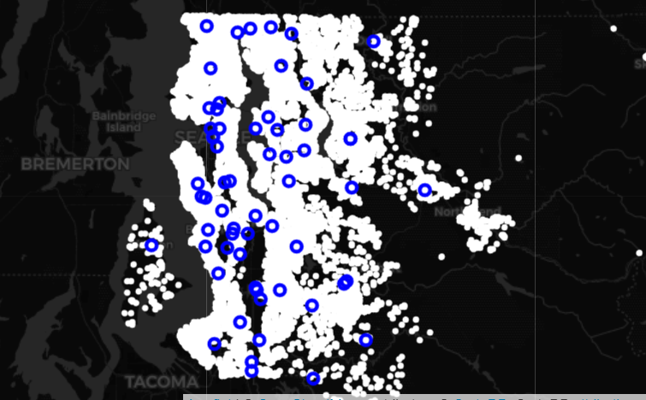
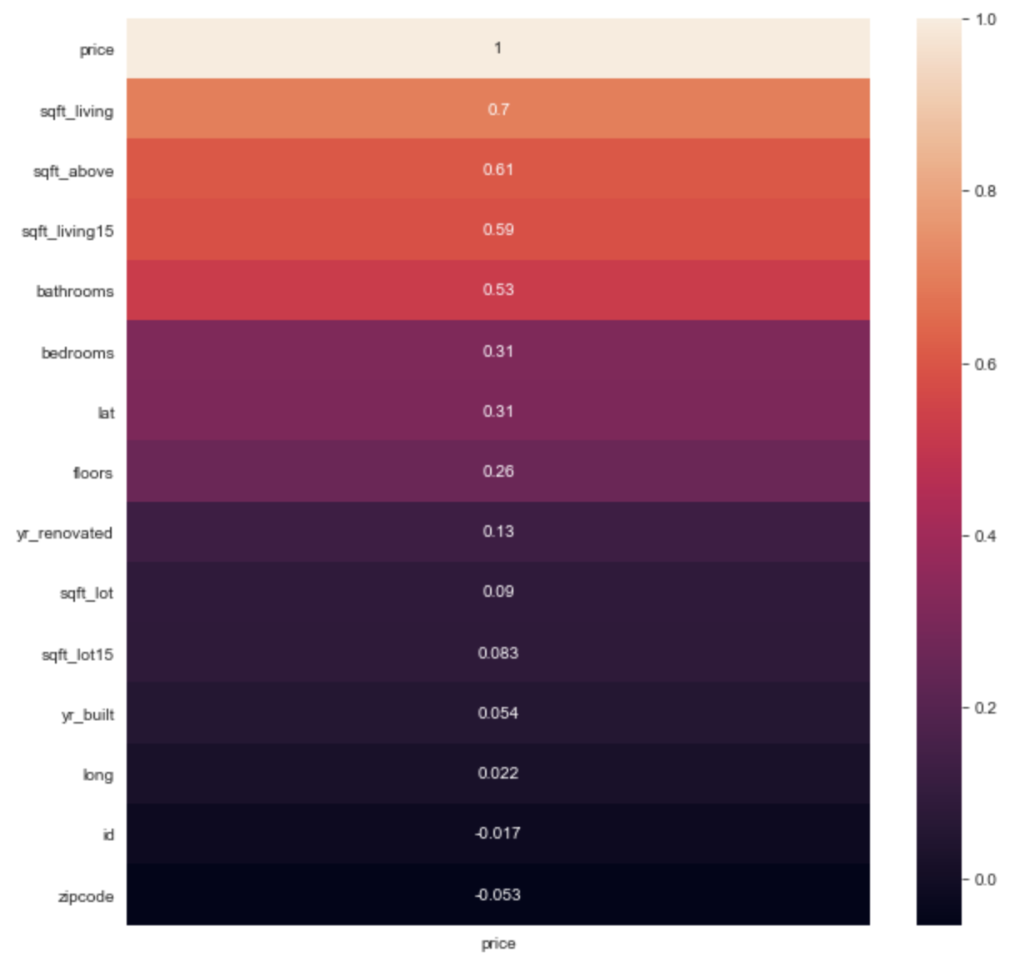
EDA
Examined correlation between price and other features
Mapped location data
Determined outliers to “single family home”

Slide 6
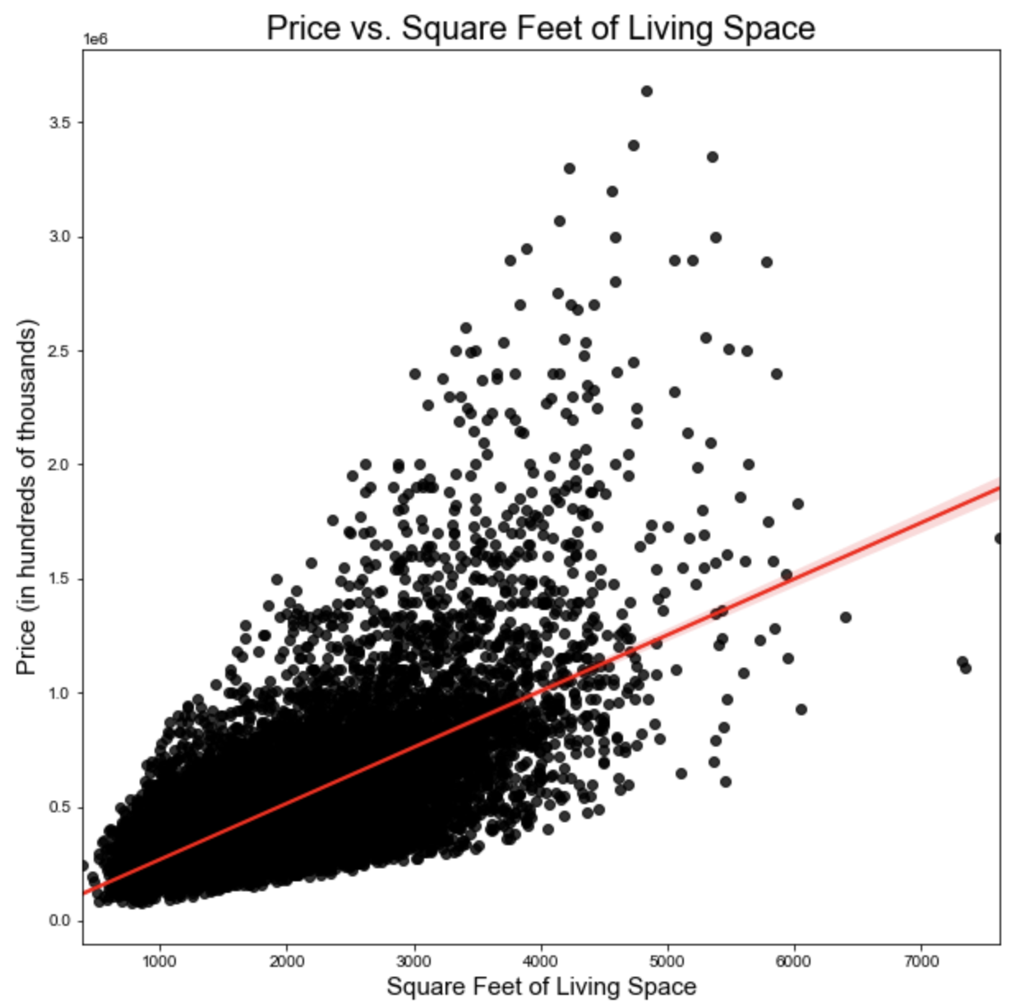
Data Analysis – Numeric Features
As housing square footage increases so does price

Slide 7
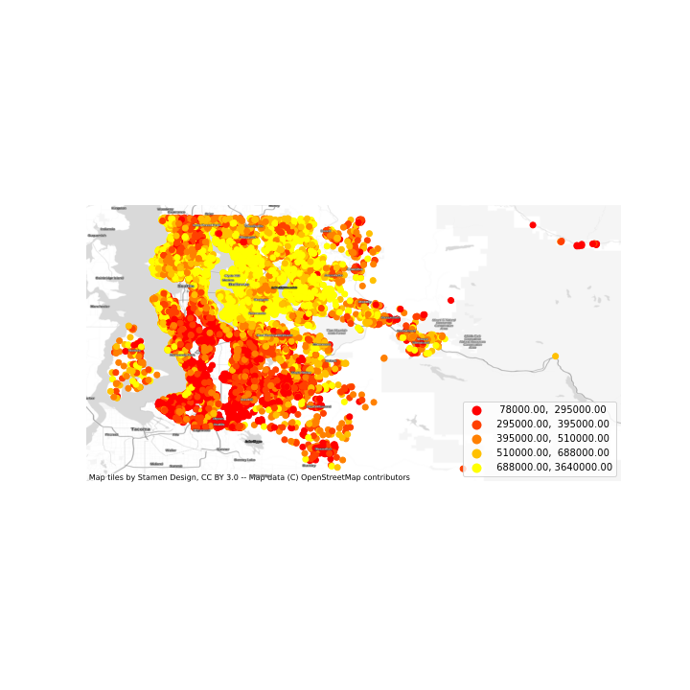
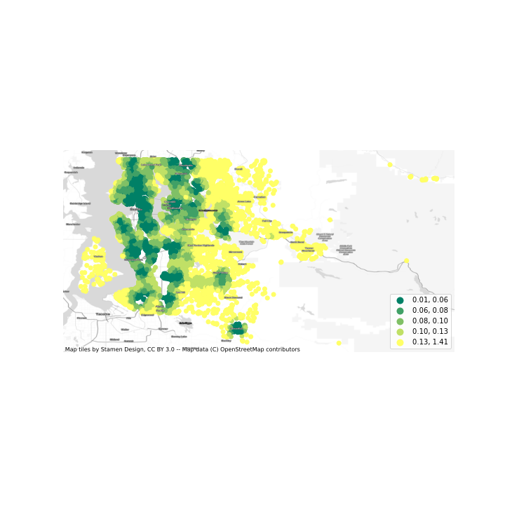
Data Analysis – Geodata Features
GRAPHIC TO COME
Total Distance in Degrees from Points of Interest per House
Price in Dollars per House
Notes:
Engineering the feature, confirming viability

Slide 8
Data Analysis – Categorical Features
GRAPHIC TO COME
Notes:
Engineering the feature, confirming viability

Slide 9
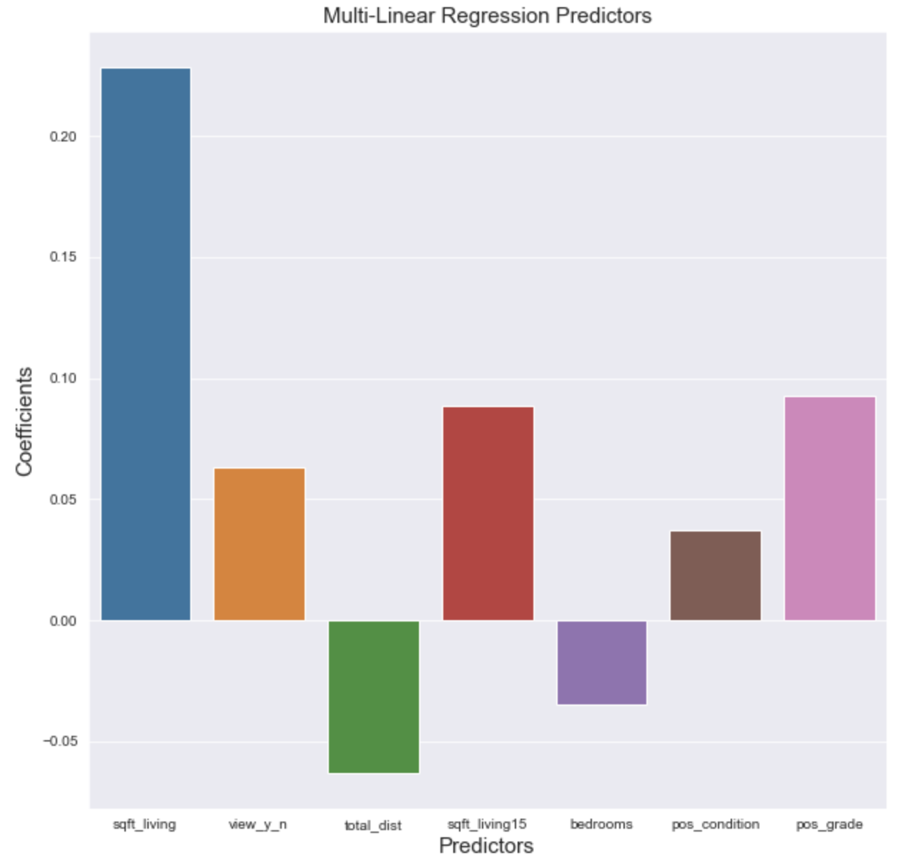
Results

Slide 10
Results
Model explains 52% of the variance in sales prices for homes in King County
Square footage : 23% increase in sales price
Square footage of 15 closest neighbors: 9% increase in sales price
High Grade: 9% increase in sales price
View: 6% increase in sales price
Location: 6% decrease in sales price
Number of bedrooms: 4% decrease in sales price

Slide 11
Next Steps & Improvements
Add more location data
Feature engineering with Condition and Grade
Identify relationships with Year Built and Year Renovated
Explore room number and type
Leverage zip code data
Examine properties with multiple sales records
Price changes
Feature changes

Slide 12

Thank you!
COPPER
CONSULTING

Slide 13
Appendix

